Slide 1



Retirement Services Office
600 Henley Street, 221
UT CONFERENCE CENTER BUILDING
(865) 946-8847 or 1-888-444-UTHR
retirement@tennessee.edu
Notes:
Introduce yourself and the department to the Orientation Participants.
“I’d like to introduce you to our department’s favorite employee.”
<Next Slide>

Slide 2


Planning Your
Retirement
Pension
Social
Security
Personal
Savings

Slide 3






Are you a previous member?
Where you enrolled in a previous TN retirement plan?
What do you need to do?
  Go online to check and/or update your address, beneficiary(ies) and investment choices
    TCRS - https://mytcrs.tn.gov
    ORP - http://treasury.state.tn.us/orp/index.html and company sites
    Restart Contributions for Deferred Compensation Plans by going online or using the paper form:
      401(k) - www.retirereadytn.gov
      457 - www.retirereadytn.gov
      403(b) (company site)

Slide 4

STATE OF TENNESSEE
PENSION PLANS
Mandatory for Regular Full-Time Employees
Hybrid Plan contributions as follows:
    9% of salary paid by employer – TCRS-H
    OR
    9% of salary paid by employer – ORP-H
    PLUS
    5% of salary paid by employee regardless of plan choice

Slide 5
STATE OF TENNESSEE
TCRS HYBRID PLAN
1. TCRS-H (Tennessee Consolidated Retirement System Hybrid):
    Exempt and non-exempt employees are eligible
    Both Defined Benefit and Defined Contribution
    TCRS Board is responsible for investing funds
    5 year vesting period - May want to join this plan if you plan on being at UT 5 years or more
    Disability Retirement option (once vested)
    Unused sick leave transfers into months of service at retirement
    Guaranteed Lifetime Benefit
    You can purchase past temporary or student worker service
    Your pension is determined by:
        Salary
        60 highest consecutive months of service
        Age

Slide 6
STATE OF TENNESSEE
ORP HYBRID PLAN
2. ORP-H (Optional Retirement Program Hybrid):
    Exempt faculty and staff are eligible
    Defined Contribution Plan – Market driven and funds may fluctuate
    Employee chooses investment options with
    AIG, TIAA, and/or VOYA
    No vesting period – May want to join this plan if:
        You are unsure how long you will be employed at UT
        Paid by a grant
        Postdoctoral position
        Coaching position
        You would like to be more hands-on with your retirement planning

Slide 7
PENSIONS Q & A
Can I switch retirement plans? If you are a non-exempt employee, you CANNOT switch retirement plans. Exempt employees are able to switch from TCRS to ORP at anytime, one time only! Exempt employees enrolled in the ORP plan can switch from ORP to TCRS after 5 years of credible service. *The State will contact you with details.
Is it mandatory that I participate in a retirement plan? Yes, participation in a retirement plan is a condition of employment for regular full-time employees and optional for regular part-time employees. You cannot opt-out, reduce, or delay the start of participating the retirement plan.
What do I miss out on by not being vested in TCRS? By not being fully vested in TCRS you miss out on the 4% that is contributed into TCRS by the University.

Slide 8
PENSIONS Q & A
What paperwork do I need to turn in? Only exempt employees will need to turn in paperwork! Exempt employees will need to submit the Notice of Election to Participate Form. If you will elect to participate in the ORP retirement plan, you will also need to submit the Premium Distribution Specification Form. These forms are due one week from your start date. Bi-weekly Employees are automatically enrolled into TCRS.
What happens if I do not submit my retirement paperwork? If employees make the decision to not submit their required retirement forms, they will eventually be defaulted into the TCRS Retirement plan. **Any missed retirement contributions will automatically be caught up out of one paycheck.

Slide 9
Auto Enrollment – 401(k)
Auto enrollment for 2% of your gross pay each paycheck. However, employees may opt out of this contribution.
        1. TCRS Hybrid Plan: Employer already contributing 5% -
        Funds are invested into your 401(k) plan into the funds of your choice (Mandatory)
        Plus Employee 2% (Optional)
        2. ORP Hybrid: Employee 2% (Optional)
Notes:
TCRS Hybrid Plan.

Slide 10

FREE MONEY!

Slide 11
401(k) Q & A
Do you have a history at UT? If you have been in the University of Tennessee System for any reason, you will NOT be automatically enrolled into the 401k plan at 2%, you will need to fill out a 401k enrollment form.
What company is my 401k with? Empower Retirement is the only 401k company available for you to choose from.
What is the maximum matching contribution? $50.00 per month. If you are bi-weekly, it is $25.00 per paycheck.
Can you stop deferring at any time? Yes, employees can start, stop, or make changes at anytime to your deferred compensation plans (401k, 457, 403b). To make changes, please contact the Retirement Services Office.
If I opt-out of the 401k plan when first hired, can I rejoin at a later date? Yes, you can rejoin at any time. Please contact the Retirement Services Office for an enrollment form.

Slide 12
401(k) Q & A
Can you withdraw your money at any time? There several withdrawal options available for employees still employed at UT. There are loans and hardships available in the 401k plan. The employee will need to contact Empower Retirement at 1-800-922-7772 for details.
If you make 401k changes online. If you make changes online, please use caution! If you accidentally enroll into a 457 plan instead of a 401k plan, you will not receive a matching contribution. The only deferred compensation plan with matching contributions is the 401k plan.
If you opt-out of the 401k plan, will you receive a matching contribution? No!

Slide 13
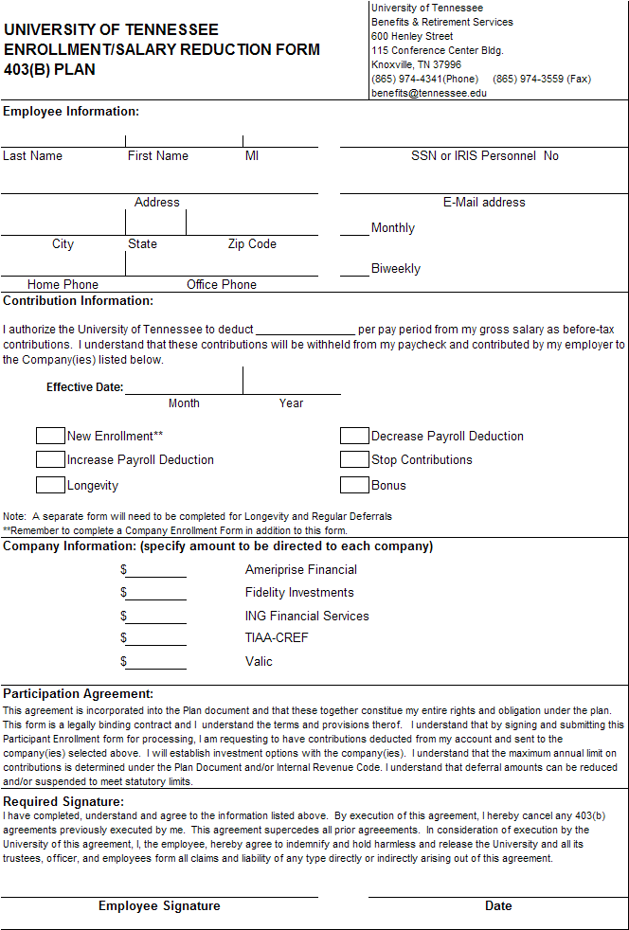




403(b) PLAN
Five Companies to choose from:
AIG
Ameriprise Financial
Fidelity Retirement
TIAA
VOYA
If interested, please submit an application from the Company (or companies) you choose plus the UT 403(b) Enrollment/Salary Reduction Form.

Slide 14
STAY WITHIN THE LIMITS . . .
The 401(k) and the 403(b)
fall under the same annual limit of…
$19,000 for under age 50
$25,000 for age 50 or older
Notes:
limit between the two plans.

Slide 15
457 PLAN
This plan is also managed by Empower Retirement and has the same investment options as the 401(k) plans!
Has its own annual limit of:
    $19,000 for Under 50
    $25,000 for 50 and Over
  Plus…
  No early withdrawal penalty!
www.retirereadytn.gov

Slide 16
FREQUENTLY ASKED QUESTIONS
Can you transfer your current tax deferred income into UT’s TDI program? Yes, you can transfer your current tax deferred income into a 401k plan or a 403b plan. Contact Empower Retirement at 800-922-7772 or one of the five available 403b companies.
If I am enrolled in TCRS and leave before I am vested, can I be refunded my contributions to the Pension Plan? Yes. You will need to contact the State for details. If you withdraw your funds, you will lose your service time in TCRS.
Is there a 5-year vesting period for contributions going to the 401k? No. Both employee and employer contributions are vested from day one.

Slide 17
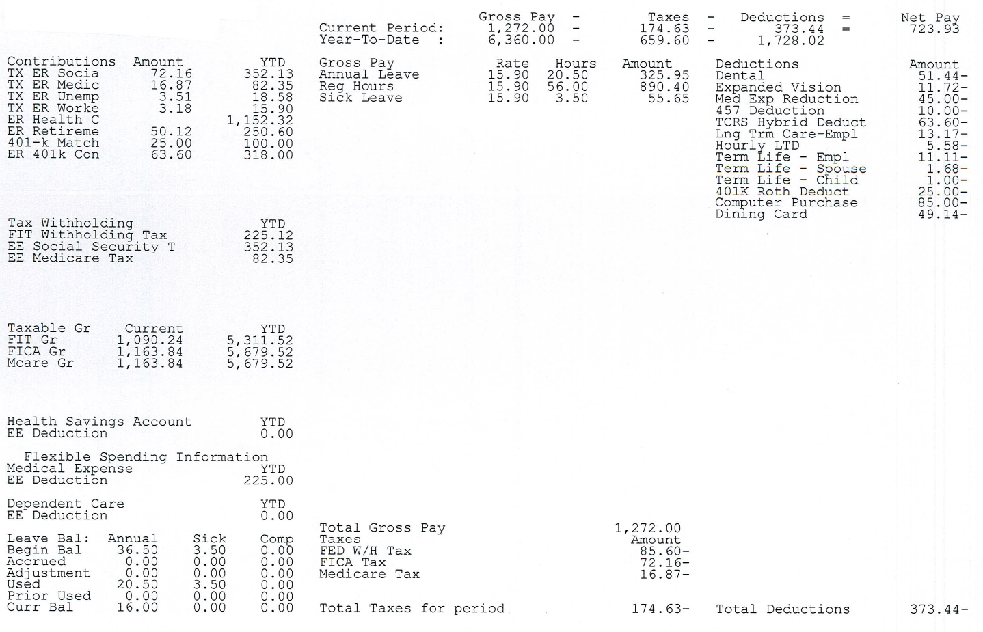
CHECK YOUR PAY STATEMENT OFTEN

Slide 18
IMPORTANT THINGS TO REMEMEBER
Check your pay statement often! Everything you are enrolled with at the University will be listed on your check stub. If it is not listed, you are NOT enrolled!
What is the minimum amount that you can contribute to the 401k plan? The minimum amount that you can contribute to a 401k plan is $20.00 per month. If you are bi-weekly, that’s $10.00 per paycheck.
Matching Contributions – Only the 401k plan has a matching contribution. The 457 and 403b plans do not have a matching contribution!
Personnel No. – Write your six digit personnel number and pay frequency (M/B) on all forms that you submit.

Slide 19
WE ARE HERE TO HELP!
For any additional Payroll or Retirement questions,
please see us in the back!
Feel free to submit any completed forms today.

